Slide 1
Unit 5
PCA & SVD

Slide 2
Principal Component Analysis
Principal component analysis, or PCA, is a dimensionality reduction method that is often used to reduce the dimensionality of large data sets, by transforming a large set of variables into a smaller one that still contains most of the information in the large set.
Reducing the number of variables of a data set naturally comes at the expense of accuracy, but the trick in dimensionality reduction is to trade a little accuracy for simplicity. Because smaller data sets are easier to explore and visualize and make analyzing data points much easier and faster for machine learning algorithms without extraneous variables to process.
So, to sum up, the idea of PCA is simple — reduce the number of variables of a data set, while preserving as much information as possible.

Slide 3
Introduction
PCA works by computing the principal components and performing a change of basis.
It retains the data in the direction of maximum variance.
The reduced features are uncorrelated with each other. These features can be used for unsupervised clustering and classification.
Firstly, PCA computes the covariance matrix. Then we find the eigen vectors and eigen values of the covariance matrix. After that, we project the data along the eigen vectors. If the original data has a dimensionality of n, we can reduce dimensions to k, such that k≤ n.

Slide 4
STEPS
Standardize the range of continuous initial variables
Compute the covariance matrix to identify correlations
Compute the eigenvectors and eigenvalues of the covariance matrix to identify the principal components
Create a feature vector to decide which principal components to keep
Recast the data along the principal components axes

Slide 5
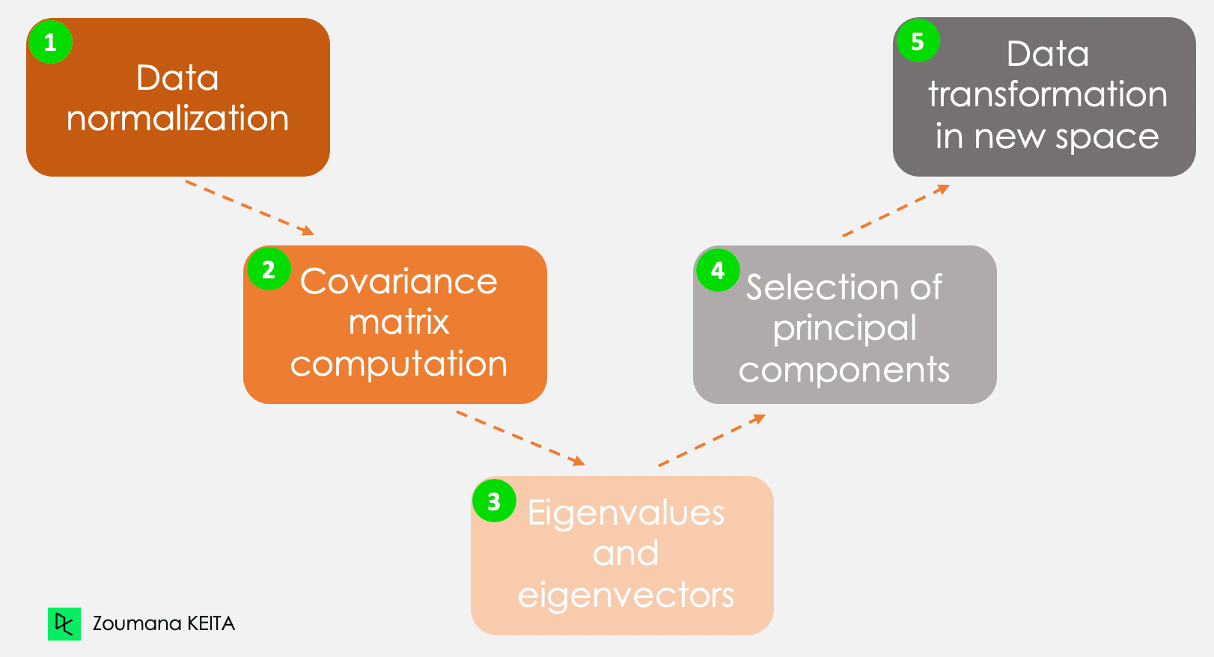

Slide 6

STEP 1: STANDARDIZATION
The aim of this step is to standardize the range of the continuous initial variables so that each one of them contributes equally to the analysis.
More specifically, the reason why it is critical to perform standardization prior to PCA, is that the latter is quite sensitive regarding the variances of the initial variables.
That is, if there are large differences between the ranges of initial variables, those variables with larger ranges will dominate over those with small ranges (for example, a variable that ranges between 0 and 100 will dominate over a variable that ranges between 0 and 1), which will lead to biased results. So, transforming the data to comparable scales can prevent this problem.
Mathematically, this can be done by subtracting the mean and dividing by the standard deviation for each value of each variable.

Slide 7
STEP 2: COVARIANCE MATRIX COMPUTATION
The aim of this step is to understand how the variables of the input data set are varying from the mean with respect to each other, or in other words, to see if there is any relationship between them. Because sometimes, variables are highly correlated in such a way that they contain redundant information. So, in order to identify these correlations, we compute the covariance matrix.
The covariance matrix is a p × p symmetric matrix (where p is the number of dimensions) that has as entries the covariances associated with all possible pairs of the initial variables. For example, for a 3-dimensional data set with 3 variables x, y, and z, the covariance matrix is a 3×3 data matrix of this from:

Slide 8

What do the covariances that we have as entries of the matrix tell us about the correlations between the variables? It’s actually the sign of the covariance that matters: If positive then: the two variables increase or decrease together (correlated) If negative then: one increases when the other decreases (Inversely correlated)

Slide 9
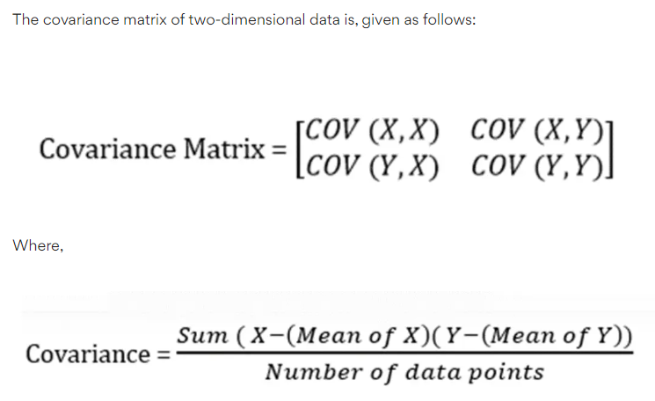

Slide 10
STEP 3: COMPUTE THE EIGENVECTORS AND EIGENVALUES
Eigenvectors and eigenvalues are the linear algebra concepts that we need to compute from the covariance matrix in order to determine the principal components of the data. Before getting to the explanation of these concepts, let’s first understand what do we mean by principal components.
Principal components are new variables that are constructed as linear combinations or mixtures of the initial variables.
These combinations are done in such a way that the new variables (i.e., principal components) are uncorrelated and most of the information within the initial variables is squeezed or compressed into the first components.
So, the idea is 10-dimensional data gives you 10 principal components, but PCA tries to put maximum possible information in the first component, then maximum remaining information in the second and so on, until having something like shown in the scree plot below.

Slide 11
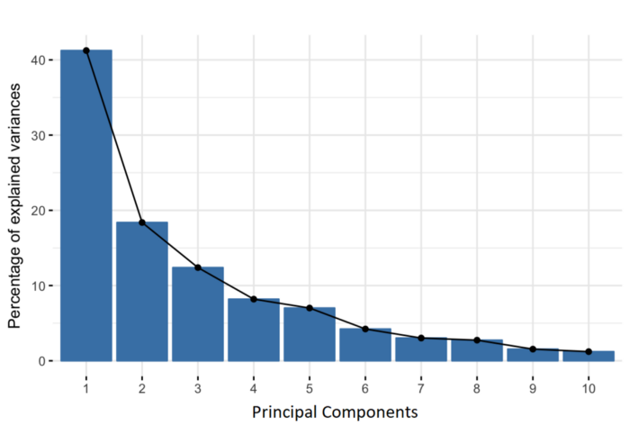
Screeplot for 10 dimensions

Slide 12
Organizing information in principal components this way, will allow you to reduce dimensionality without losing much information, and this by discarding the components with low information and considering the remaining components as your new variables.
An important thing to realize here is that the principal components are less interpretable and don’t have any real meaning since they are constructed as linear combinations of the initial variables.
Geometrically speaking, principal components represent the directions of the data that explain a maximal amount of variance, that is to say, the lines that capture most information of the data.
The relationship between variance and information here, is that, the larger the variance carried by a line, the larger the dispersion of the data points along it, and the larger the dispersion along a line, the more information it has.
To put all this simply, just think of principal components as new axes that provide the best angle to see and evaluate the data, so that the differences between the observations are better visible.

Slide 13
How PCA Constructs the Principal Components
As there are as many principal components as there are variables in the data, principal components are constructed in such a manner that the first principal component accounts for the largest possible variance in the data set.
For example, let’s assume that the scatter plot of our data set is as shown below, can we guess the first principal component ? Yes, it’s approximately the line that matches the purple marks because it goes through the origin and it’s the line in which the projection of the points (red dots) is the most spread out.
Or mathematically speaking, it’s the line that maximizes the variance (the average of the squared distances from the projected points (red dots) to the origin).

Slide 15
The second principal component is calculated in the same way, with the condition that it is uncorrelated with (i.e., perpendicular to) the first principal component and that it accounts for the next highest variance.
This continues until a total of p principal components have been calculated, equal to the original number of variables.
Now that we understand what we mean by principal components, let’s go back to eigenvectors and eigenvalues. What you first need to know about them is that they always come in pairs, so that every eigenvector has an eigenvalue. And their number is equal to the number of dimensions of the data. For example, for a 3-dimensional data set, there are 3 variables, therefore there are 3 eigenvectors with 3 corresponding eigenvalues.
Without further ado, it is eigenvectors and eigenvalues who are behind all the magic explained above, because the eigenvectors of the Covariance matrix are actually the directions of the axes where there is the most variance (most information) and that we call Principal Components. And eigenvalues are simply the coefficients attached to eigenvectors, which give the amount of variance carried in each Principal Component.
By ranking your eigenvectors in order of their eigenvalues, highest to lowest, you get the principal components in order of significance.

Slide 16
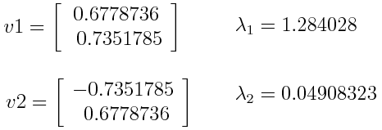
Principal Component Analysis Example:
Let’s suppose that our data set is 2-dimensional with 2 variables x,y and that the eigenvectors and eigenvalues of the covariance matrix are as follows:

Slide 17
If we rank the eigenvalues in descending order, we get λ1>λ2, which means that the eigenvector that corresponds to the first principal component (PC1) is v1 and the one that corresponds to the second principal component (PC2) isv2.
After having the principal components, to compute the percentage of variance (information) accounted for by each component, we divide the eigenvalue of each component by the sum of eigenvalues. If we apply this on the example above, we find that PC1 and PC2 carry respectively 96 percent and 4 percent of the variance of the data.

Slide 18
STEP 4: FEATURE VECTOR
As we saw in the previous step, computing the eigenvectors and ordering them by their eigenvalues in descending order, allow us to find the principal components in order of significance. In this step, what we do is, to choose whether to keep all these components or discard those of lesser significance (of low eigenvalues), and form with the remaining ones a matrix of vectors that we call Feature vector.
So, the feature vector is simply a matrix that has as columns the eigenvectors of the components that we decide to keep. This makes it the first step towards dimensionality reduction, because if we choose to keep only p eigenvectors (components) out of n, the final data set will have only p dimensions.

Slide 19


Principal Component Analysis Example:
Continuing with the example from the previous step, we can either form a feature vector with both of the eigenvectors v1 and v2:
Or discard the eigenvector v2, which is the one of lesser significance, and form a feature vector with v1 only:

Slide 20
Discarding the eigenvector v2 will reduce dimensionality by 1, and will consequently cause a loss of information in the final data set. But given that v2 was carrying only 4 percent of the information, the loss will be therefore not important and we will still have 96 percent of the information that is carried by v1.
So, as we saw in the example, it’s up to you to choose whether to keep all the components or discard the ones of lesser significance, depending on what you are looking for.
Because if you just want to describe your data in terms of new variables (principal components) that are uncorrelated without seeking to reduce dimensionality, leaving out lesser significant components is not needed.

Slide 21
STEP 5: RECAST THE DATA ALONG THE PRINCIPAL COMPONENTS AXES
In the previous steps, apart from standardization, you do not make any changes on the data, you just select the principal components and form the feature vector, but the input data set remains always in terms of the original axes (i.e, in terms of the initial variables).
In this step, which is the last one, the aim is to use the feature vector formed using the eigenvectors of the covariance matrix, to reorient the data from the original axes to the ones represented by the principal components (hence the name Principal Components Analysis). This can be done by multiplying the transpose of the original data set by the transpose of the feature vector.

Slide 22
Applications of PCA
PCA techniques aid data cleaning and data preprocessing techniques.
You can monitor multi-dimensional data (can visualize in 2D or 3D dimensions) over any platform using the Principal Component Method of factor analysis.
PCA helps you compress the information and transmit the same using effective PCA analysis techniques. All these information processing techniques are without any loss in quality.
This statistic is the science of analyzing different dimensions and can also be applied in several platforms like face recognition, image identification, pattern identification, and a lot more.
PCA in machine learning technique helps in simplifying complex business algorithms

Slide 23
Since Principal Component Analysis minimizes the more significant variance of dimensions, you can easily denoise the information and completely omit the noise and external factors.
PCA in machine learning is used to visualize multidimensional data.
In healthcare data to explore the factors that are assumed to be very important in increasing the risk of any chronic disease.
PCA helps to resize an image.
PCA is used to analyze stock data and forecasting data.
You can also use Principal Component Analysis to analyze patterns when you are dealing with high-dimensional data sets.

Slide 24
Advantages of Principal Component Analysis
Easy to calculate and compute.
Speeds up machine learning computing processes and algorithms.
Prevents predictive algorithms from data overfitting issues.
Increases performance of ML algorithms by eliminating unnecessary correlated variables.
Principal Component Analysis results in high variance and increases visualization.
Helps reduce noise that cannot be ignored automatically.

Slide 25
Disadvantages of Principal Component Analysis
Sometimes, PCA is difficult to interpret. In rare cases, you may feel difficult to identify the most important features even after computing the principal components.
You may face some difficulties in calculating the covariances and covariance matrices.
Sometimes, the computed principal components can be more difficult to read rather than the original set of components.

Slide 26
Singular Value Decomposition
Introduction:
The Singular Value Decomposition of a matrix is a factorization of the matrix into three matrices. Thus, the singular value decomposition of matrix A can be expressed in terms of the factorization of A into the product of three matrices as A = USV^{T}
Here, the columns of U and V are orthonormal, and the matrix S is diagonal with real positive entries.

Slide 27
Singular value decomposition (SVD) can be looked at from three mutually compatible points of view.
On the one hand, we can see it as a method for transforming correlated variables into a set of uncorrelated ones that better expose the various relationships among the original data items.
At the same time, SVD is a method for identifying and ordering the dimensions along which data points exhibit the most variation.
This ties in to the third way of viewing SVD, which is that once we have identified where the most variation is, it’s possible to find the best approximation of the original data points using fewer dimensions.
Hence, SVD can be seen as a method for data reduction

Slide 28
These are the basic ideas behind SVD: taking a high dimensional, highly variable set of data points and reducing it to a lower dimensional space that exposes the substructure of the original data more clearly and orders it from most variation to the least.
What makes SVD practical for NLP applications is that you can simply ignore variation below a particular threshold to massively reduce your data but be assured that the main relationships of interest have been preserved

Slide 29
SVD is based on a theorem from linear algebra which says that a rectangular matrix A can be broken down into the product of three matrices - an orthogonal matrix U, a diagonal matrix S, and the transpose of an orthogonal matrix V . The theorem is usually presented something like this:
A_{mn} = U_{mm}S_{mn}V ^{T} _{nn}
where U ^{T}U = I, V ^{T} V = I;
the columns of U are orthonormal eigenvectors of AA^{T} ,
the columns of V are orthonormal eigenvectors of A^{T}A,
and S is a diagonal matrix containing the square roots of eigenvalues from U or V in descending order.

Slide 30
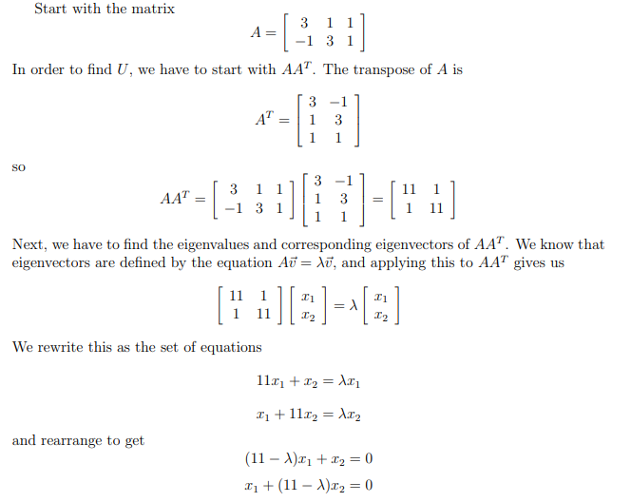

Slide 31
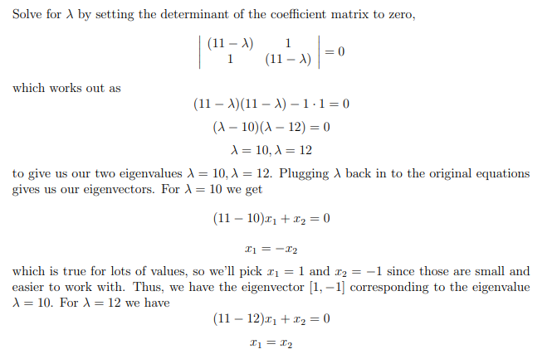

Slide 32



Slide 33
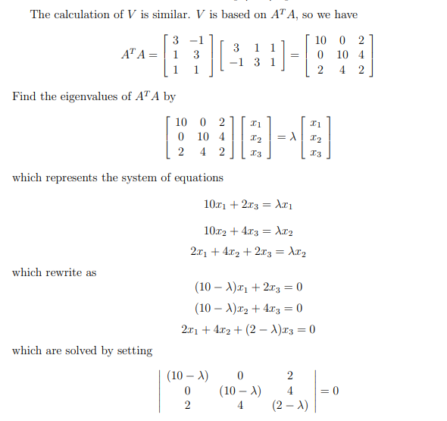

Slide 34
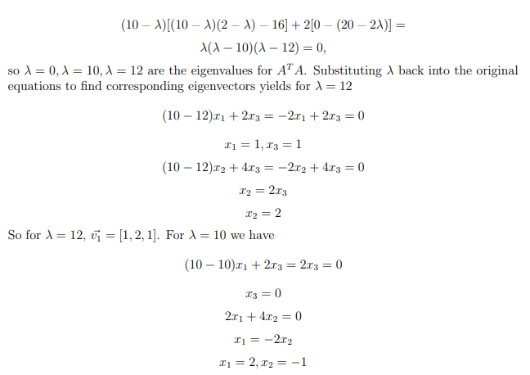

Slide 35
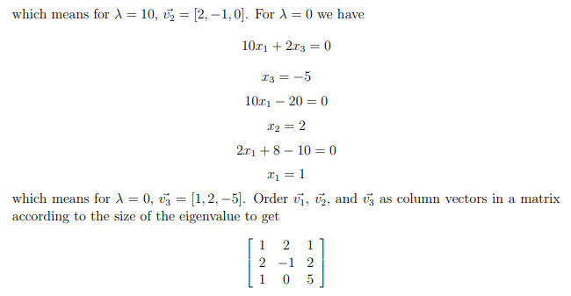

Slide 36
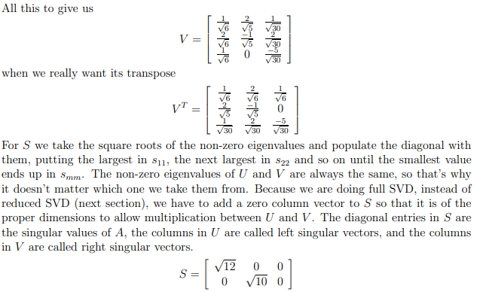

Slide 37
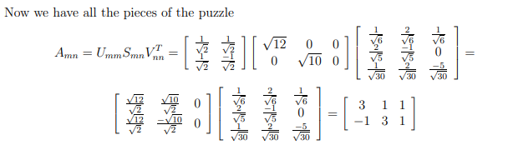

Slide 38
Singular value decomposition (SVD) is a powerful mathematical technique that has many applications in various fields. Here are some examples:
Image compression: SVD can be used to compress images by reducing the number of singular values and corresponding matrices. This technique is widely used in digital image processing.
Data analysis: SVD can be used to analyze large datasets and extract meaningful patterns and relationships between variables. This is particularly useful in fields such as finance, economics, and social sciences.
Recommender systems: SVD can be used to build recommender systems that suggest products or services based on user preferences. This is commonly used in e-commerce and online advertising.
Natural language processing: SVD can be used to analyze and summarize large text datasets, such as news articles or social media posts.
Signal processing: SVD can be used to filter noise from signals and extract important features. This is commonly used in audio and video processing.
These are just a few examples of the many applications of SVD. Its versatility and effectiveness make it a valuable tool in many different fields.

